Slide 1
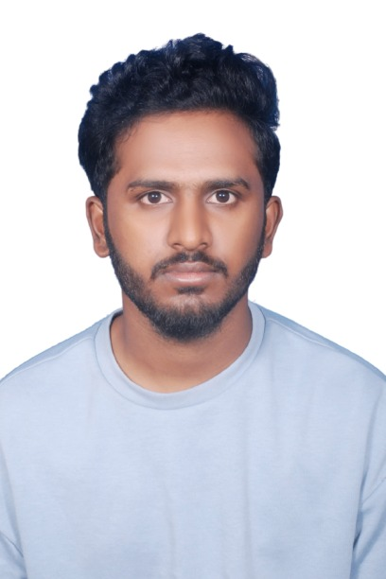
Name: Karanam Yeswanth Teja
UST Role: Junior SRE
Location: Hyderabad
Family: Parents and Brother
Total Work Experience: Python Developer Intern – Nexiilabs, Vizag, AndhraPradesh ( Sept 2024 - Oct 2024 )
• Worked on multiple real-time projects involving web scraping using Python and Playwright, including LinkedIn data extraction.
• Contributed to the development of an e-commerce application using Python, Django, and REST APIs.
• Gained hands-on experience in backend development, API integration, and data automation tasks.
College Project: Heart Disease Prediction using Machine Learning
Technology courses attended: NA
Professional Certificates : AWS Cloud Practitioner
Professional skill set: Git, Jenkins, Docker, Kubernetes, Ansible, Terraform, Cloud Formation, Python, Django web Framework, AWS
Hobbies: Drawing, Playing Cricket, Fitness
Interest: Listening to Music, Watching Movies, Travelling

